Slide 1
S.5 ECOLOGY
By
SSEFF
BScED (Hons) MUK
EMAIL: info4freds@gmail.com
Hotline: +256754958643/+256776958643

Slide 2
INTRODUCTION
Defn.
Forms of ecology
Importance of ecology
Terminologies [terms used].
Ecosystems.
Energy flow in ecosystem.

Slide 3
Introduction conti…
Efficiency of energy transfer.
Primary productivity
Gross primary productivity (GPP)
Net primary productivity (NPP)
Secondary productivity
Food chains; webs; ecological pyramids.

Slide 4
Intro….
Population ecology.
Measurements
Population size
Population distribution
Community Interactions.
Biogeochemical cycles.
Growth curves; S(sigmoid); J(boom & burst).

Slide 5
Intro…..
Other important concepts
Cycles e.g. of phytopthora infestans.
Succession.
Natural resources.
Effect of man [global warming].
Fire.
Terrestrial ecosystems [tropical rain forests; deserts; savannah]
Aquatic ecosystems [marine; fresh water]

Slide 6
DEFINITION
Is the scientific study and analysis of the interaction organisms with each other and their abiotic environment.
In other words, it is the scientific study of the interactions that determine the distribution and abundance of organisms within a particular environment.

Slide 7
FORMS OF ECOLOGY
Autecology; study of interaction of organisms of a single species and their environment. i.e. population ecology. E.g. Impalas in a national park and their diet, reproduction, competitors& predators etc
Synecology; study of interactions of species and their environment i.e. community ecology. E.g. Relationships of Impalas, wild pigs, elephants, impala predators etc in queen Elizabeth national park

Slide 8
IMPORTANCE OF ECOLOGY
Provides information about composition and interactions in the environment for biological control and maximum environmental utilization.
Enables to relate structures to functions.
Accounts for evolutionary adaptations of organisms.

Slide 9
Importance …..
Effects monitoring of environments to minimize damage/reverse it.
Designing biological control mechanisms.
Designing conservation strategies.
Definition of factors responsible for environmental damage.

Slide 10
TERMINOLOGIES
1. Habitat: Specific area in an environment where an organism lives successfully. Each habitat has microhabitats each with microclimate e.g. underside of a leaf and upper side of a leaf; upper side of a stone and lower side of a stone.
NB: Microhabitat; is a small locality within the habitat with particular conditions that support specific organisms like the underside of the fallen log for earthworms and the upper side for mosses

Slide 11
Terminologies conti……
2. Ecological niche[niche]: Is the precise place where an organism lives and the role it plays in the habitat. i.e. Profession and address of the organism.
In other words; is the sum total of functions the organism occupies in an habitat.

Slide 12
Types of ecological niche
(a) Realized niche
Is a most restricted area of a habitat that an organism occupies as a result of presence of predators, competitors, and parasites; limiting the habitat and roles performed by an organism, it’s smaller in size.
(b) Fundamental niche
Is an entire area an organism can occupy in the absence of predators, competitors, and parasites; allowing the organism experience a larger habitat and perform a variety of roles.
Notes:
ACCEPT: Physical conditions/ set of conditions in absence/presence of other spp or constraining factors.

Slide 13
Terms…..
3. Population: A group of individuals of same species in a specific area at a given time.
In other words; Is the total number of organisms of the same species occupying a specific area at the same time.
4. Population density: Number of individuals of the same species per square kilometre in a given time.
5. Community: Group of individuals of different species in a specific area at a given time.

Slide 14
Terms…..
6. Flora and fauna: Plants and animals respectively.
7. Biomass: Total quantity of living organic matter.
8. Species: Group of organisms capable of interbreeding & give rise to viable(fertile) offsprings.

Slide 15
Species
Native species: Species that normally thrive in a particular ecosystem.
Alien species: Species that migrate to the ecosystem/ that are introduced into the ecosystem and they are normally don’t thrive in the ecosystem.
Indicator species: species that needs special environmental conditions to survive and serve as early warnings of environmental pollution to a community/ecosystem. E.g. Lichens and mayflies etc
Notes:
Indicator spp: Its presence & in what number provides information about the env’t regarding pollution.

Slide 16
Species….
(d) Keystone species: A dominant spp that dictates community structure by affecting the abundance of other spp E.g. Top predators, forest regenerators like birds and bats, forest openings creators like elephants, nutrient recyclers like dung beetles
In other word; animals which have an impact on the surrounding and if they are removed the ecosystem is affected.

Slide 17
Terms …..
9. Trophic level: Feeding level; indicates feeding position of an organism in a food chain.
10. Biotic potential: The maximum reproductive capacity of an organism under ideal conditions.
11. Ecosystem: Is a natural unit composed of biotic and abiotic components whose interactions form stable self-sustaining system. e.g. aquatic & terrestrial ecosystem.

Slide 18
Term…….
Biotic factors: Living components of the environment. i.e. plants & animals.
Abiotic factors: Non living components of environment. i.e. soil; air; temperature etc
12. Carrying capacity: Maximum number of individuals the environment can sustain using the available resources in a given time; without causing depletion of the resources.

Slide 19
Terms ….
13. Ecological energetics: The study of the flow of energy through the primary consumers [herbivores + plant parasites].
14. Trophic efficiency: The percentage of the energy at one trophic level which is incorporated into the next trophic level.
15. Biomes: Large geographical regions of the earth characterized by a distinct climate and specific life forms especially vegetation e.g. Deserts, savannah grasslands, tropical rain forests, tundra and temperate forests etc.
Notes:
Biomes are divided into smaller units called zones; ground zone, canopy zone etc.

Slide 20
Terms ….
16. Biosphere/ ecosphere: Part of the earth that can be inhabited by organisms.
17. Ectone: Region between 2 adjacent ecosystems containing a mixture of species from either of the ecosystems and usually species not found in either of bordering ecosystems e.g. wetland btn dry land & open water lakes; small trees btn grassland & forest.

Slide 21
Terms…..
18. Controlling; killing of animals which are disturbing people.
19. Culling; removing some animals in order to control population
20. Cropping; killing of animals for purpose such as food, ivory, skins etc

Slide 22
ECOSYSTEMS
THE ECOSYSTEM
MAJOR COMPONENTS
Abiotic (non-living) components; physical and chemical factors that influence living organisms
Biotic(living) components; Plants, animals and microorganisms that influence living organisms.

Slide 23
THE ECOSYSTEM
NB: Ecosystems can be aquatic/ terrestrial.
Aquatic ecosystems comprise of water localities and terrestrial ecosystems comprise of the land localities.

Slide 24
MAJOR ABIOTIC FACTORS
………..affecting terrestrial ecosystems;
Edaphic factors (9);
Climatic factors (5)
[Know at least 2 functions of each].

Slide 25
CLIMATIC FACTORS
Light (Intensity, quality & duration)
Intensity; affected by angle of incidence of sun’s rays to earth’s surface; depending on latitude, season, time of day, aspect of slope.
Quality; e.g. the pond example of bacteria and plants (in water).
Duration (photoperiod); at equator; 12hrs but varies seasonally at higher latitudes.

Slide 26
Climatic factors conti…..
Source of energy for photosynthesis.
Activity variation [photoperiodic responses]
Germination.
Migration.
Hibernation.
Flowering.
Chlorophyll formation & bleaching

Slide 27
LIGHT
Mating e.g. in fireflies.
Etiolation
Bulb formation
Reduces leaf-fall
Breaks bud dormancy
Vitamin D
Skin cancer

Slide 28
Light
Photoreception
Stomatal mechanism
Drives energies from atoms

Slide 29
TEMPERATURE
2. Temperature
Soil formation
Migration
Transpiration & sweating rates
Photosynthesis
Vernalisation & germination

Slide 30
TEMPERATURE
Breaks bud dormancy
Hibernation/aestivation e.g. African lung fish, bats, rats, earthworms & garden snails.
Microclimatic variation in distribution by vegetation due to temperature.
Enzymes effect

Slide 31
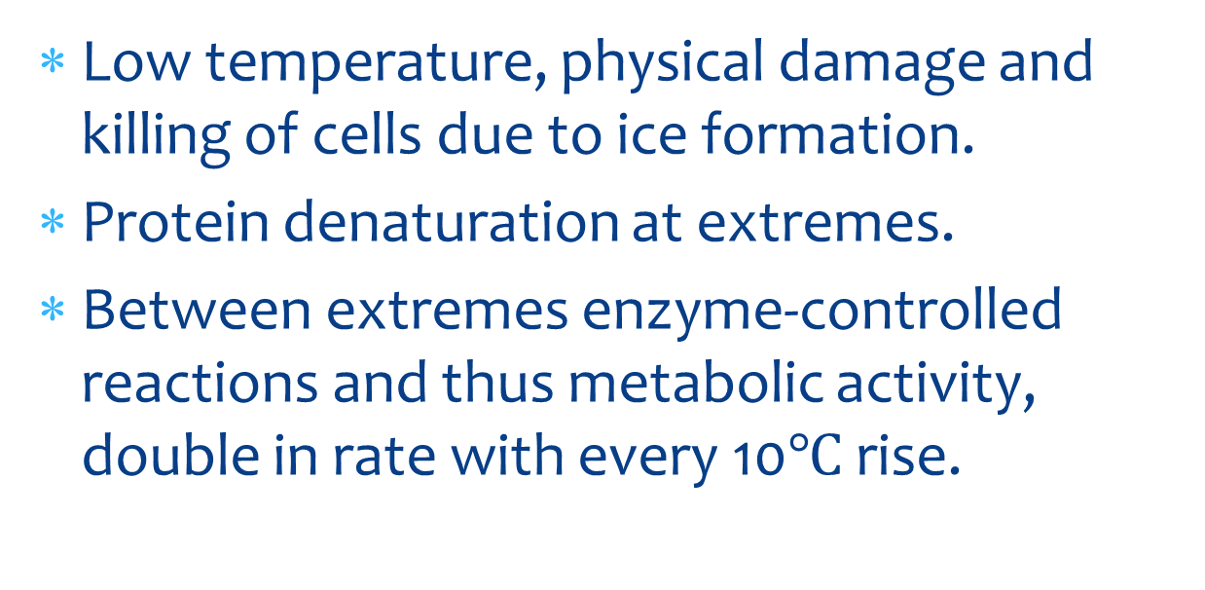
ENZYMES EFFECT
Low temperature, physical damage and killing of cells due to ice formation.
Protein denaturation at extremes.
Between extremes enzyme-controlled reactions and thus metabolic activity, double in rate with every 10$℃$ rise.

Slide 32
WATER
3. Water (Moisture & salinity)
It is a nutrient, coolant, reaction medium, habitat among others
And its so relative availability enhances interactions of organisms.

Slide 33
WATER
NB: Chemical components affecting the availability of organisms include [CO2], [O2], organic food substances, inorganic chemicals of life etc
All affect the interaction & abundance of living organisms in an area

Slide 34
WATER
Rapid drainage, low rainfall + high evaporation thus dry soils.
Opposite of the above; water logged areas. Plants classified according to tolerance of water;

Slide 35
WATER
E.g.
High tolerance=xerophytes.
Medium tolerance =mesophytes.
Low tolerance =hydrophytes.
[ HINT: Adaptations for each above + halophytes; Refer to excretion and osmoregulation]

Slide 36
Atmosphere[air+ water currents]
4. WIND[MOVING AIR]
Transpiration, sweating decrease
Dispersal
Migration of flyers
Distorted frequency of growth,
Pollution
Rainfall formation

Slide 37
WIND ….
Circulates atmospheric gases
Mineral salts distribution & Oxygen of water
Damage
Notes:
Atmospheric circulation (of gaseous content e.g. ${CO}_{2},O_{2}$& air contents) due to energy from sun; air pressure, and weather systems.
Important in distribution of water vapour picked up after evaporation or in moving air masses.
Even pollutant gases.
Dispersal of spores, seeds and fruits.

Slide 38
HUMIDITY
5. Humidity
Evaporation from leaves/transpiration rate;
Heat loss
Etc

Slide 39
SEASONALITY
Some seasons are associated with favourable factors of;
Light
Temperature
Water
Visibility
Humidity
Etc

Slide 40
SEASONALITY …
Seasons are associated with general favourable conditions like;
Generally spring provides favourable conditions while…
….summer & antumn are unfavourable seasons to ecological biota.

Slide 41
EDAPHIC FACTORS
SOIL FACTORS; mass of organic and inorganic components support life.
Soil PH; most plants [almost neutral]; some acidic like tea & tobacco; affects rate of enzymatically controlled activities & general activity levels of biota;
Soil temperature; earthworms inactive at low temperatures of soil.
Nature & size of particles(Nature of parent rocks); soil structure; affect rate of weathering, nature of soil and nutrients in soil.

Slide 42
Soil factors …..
(iv) Biotic content; soil living organisms; macro organisms e.g. earth worms & microorganisms like fungi and bacteria; decomposition(feed on DOM), ingest mineral particles, mix soil, faecal pellets hold together soil particles, burrows aerates, humus, crumb structure etc
(v) Mineral content(inorganic particles); Mineral matter; sandy soils; drainage; texture; and the opposite.

Slide 43
Soil factors …
(vi) Humus content/organic matter content; humus has effect of breaking clogs of clay & improving sandy soils.
Organic matter( Dead OM+ living organisms); major source of key nutrients; P, S, N.
High organic matter; warm, dark, closely packed soil.
Low organic matter; cool, loose soils.

Slide 44
Soil factors …
(vii) Air content; respiration for soil living organisms; and plant roots; nutrient availability like nitrification.
(viii) Water content; crops like rice do survive in conditions of lots of water since they have root tissues with airspaces that provide oxygen to allow humus breakdown soil particles in water logged areas.

Slide 45
Soil factors …
(ix) Topography; steepness and gradient of a place;
aspects [slopes-N/S facing; altitude; inclination];
High altitude; averagely low temperatures and atmospheric pressure compared to low lying areas; have effect on plant and animal life.
Relief barriers met by air, it rises, cools and precipitation occurs [tends to occur].
Mountains also are barriers to dispersal, migration.
Water logging; Soil erosion; light availability.
All affect plants & animals’ establishment.
Notes:
Temp; rainfall; wind speed;

Slide 46
COMBINED FACTORS
[CO2]; reactant for photosynthesis; green house effect; acid rain etc
[O2]; required for aerobism; poison anaerobes.
Fire

Slide 47
FIRE
CAUSES
Carelessness, lighting & volcanicity;
ADAPTATIONS
Grasses grow in tussocks to protect young growing buds.
Succulent stems decrease effect of fire heat
Annuals so avoid fire as seeds.
Heat resistant tissues.

Slide 48
EFFECTS OF FIRES ON ECOSYSTEM
Increased visibility.
Breaking dormancy of seeds.
Killing microorganisms in soil.
Increased visibility of prey thus predation
Destruction of some moving animals.
Smoke causing air pollution.

Slide 49
EFFECTS ….
Stimulates new buds growth
stimulates release of minerals
Stimulates steady vegetation growth
Stimulates new palatable vegetation growth
Stimulates flowering
Increases soil erosion
Decreases population density

Slide 50
NOTE
Fire favours grasses at trees’ exposure
Grasses meristems at leaf bases protected by soil layer and leaf bases.
Cambium & buds of trees exposed to fire thus growth stimulation.
Succulent plants are rare in deserts;
Tissues are heat intolerant
Succulent tissues liable to overheating due to much water and decreased transpiration due to structural modifications.

Slide 51
Note ….
Light shower of rain worse than not at all
Induces stomatal opening with than more heat & little soil water.
Start germination with decreased soil water
Start transpiration with decreased soil water.

Slide 52
Major abiotic factors affecting aquatic ecosystems
Light penetration/intensity; photosynthesis & visibility.
Water currents; turbidity, [O2], level of stress.
Dissolved nutrients; food, nourishment; biotic potential etc
Suspended solids; visibility; ease to light to penetrate through, oxygen supply etc.
Salinity; concentration of salts; determines osmotic potential of the ecosystem.

Slide 53
FACTORS IN AQUATICS ….
6. Systems’ depth; epilimnion layer richer in nutrients, light, [O2] so increase productivity.
7. [O2] for aerobism.
8. [CO2] for photosynthesis and PH
9. Seasons; winter, autumn & summer than spring.
10. PH of water; enzymatic reactions/corrode.
11. pollutants; kill biota/compromise activity.
12. Turbidity (clarity); affects visibility, photosynthesis, oxygen dissolution.

Slide 54
Factors in aquatics ….
13. Nature of parent rock; determines nutrients in water body;
14. Oil; suffocates organisms
15. Temperature; enzymatic actions
16. Radiations; genes/DNA altered, death, disorders, new traits etc.

Slide 55
BIOTIC COMPONENTS
Producers/primary producers(autotrophs): use sun’s energy, convert into organic energy/chemical energy e.g. Phytoplanktons; [algae & blue –green bacteria] & green plants. Make carbos from inorganics using sunlight during photosynthesis.
NB:
Planktons; organisms that can’t resist water movements/waves. Plants=phytoplanktons; animals=zooplanktons.
Nektons; organisms that can swim against water waves.

Slide 56
BIOTIC …..
O2 released; H2S used; CO2 used; organic food substance s made.
2. Consumers(heterotrophs): animals that get energy and nutrients by feeding on other organisms/their remains.
Classes of consumers:
Primary consumers (herbivores); feed on producers directly.
Secondary consumers(carnivores); feed on herbivores/primary consumers only.
Tertiary consumers ; feed on/ consume both herbivores & carnivores e.g predators like lions; hunt; kill & eat.

Slide 57
BIOTIC …..
(iv) Quaternary consumers, feed on high level consumers like tertiary consumers; can be predators or scavengers; feeding on corpse (marabou stocks, hyenas, vultures).
Omnivores; eat plants & animals like man, rats, bears, crocodile etc; their position can’t be ascertained.
Scavengers; feed on dead abandoned organisms/their remains e.g vultures, flies, hyenas some ants & sharks.

Slide 58
BIOTIC …..
(v) Decomposers & Detritivores;
Decomposers(saprobionts/lysotrophs), bacteria & fungi; saprophytes, feed on dead and decaying organic matter/materials and recycle nutrients.
Release ecotenzymes in the OM, digest it and absorb soluble forms of organic matter.
Recycle organic matter by;
Biodegrading DOM; results in disposal of plant litter, dead animal bodies, wastes and garbage.
Releasing simpler inorganic cpds into the soil and water for uptake by producers.

Slide 59
BIOTIC …..
Detrivores; feed on fragments of dead materials (debris) e.g. millipedes, earthworms, termites, woodlice e.t.c; don’t recycle but wait to also be fed on.
They cast off both fragments and wastes of L. organisms.
Detritous feeders/detritivores; extract nutrients from nutrients from partly decomposed organic matter in leaf litter, plant debris and animal dung.

Slide 60
Channels of ecology influence by biotic factors[ 6 major ones]
[Common interactions in ecology]
Predation
Competition
Reproduction
Protection
Parasitism
Support
Dispersal
Mimicry
Pollination
Antibiosis etc

Slide 61
CHANNELS ….
Predation; an organism(bigger) hunts; kills and eats other organisms(smaller), the prey of different species.
Competition; 2/ more individuals striving to obtain same resource in short supply. Things competed for; mates, food, light, nutrients, space/shelter, water, respiratory gases etc

Slide 62
COMPETITION ….
Types of competition
Intraspecific competition; individuals struggling for same resource in limited supply of same species.
Interspecific competition; competition between organisms of different species.
NB: These organisms can’t co-exist in both cases unless resource partitioning occurs thus COMPETITION EXCLUSIVE PRINCIPLE [Gaussian principle]; to be discussed later.

Slide 63
CHANNELS ….
3. Dispersal; many organisms depend on others for their distribution e.g. plants use a variety of animals to dispose their seeds &fruits i.e. the animals(agents) & seed/fruits (also living).
4.Pollination; flowers pollinated by living organisms.
Angiosperms depend make use of insects mainly to transfer their pollen grains from the anthers to stigma.

Slide 64
CHANNELS ….
5. Mimicry; tendency of a gp of organisms/an organism to resemble another organism i.e. resembling of other organisms in order to;
Avoid predation in some cases(scaring away predators) thus warming mimicry e.g. housefly & bee.
Getting prey. e.g. some resemble green plants at times to get prey…

Slide 65
CHANNELS ….
6. Parasitism; an organism lives on or in an organism(host) of different species; makes it a food source and causes harm [habitat; food source; harm]
7. Antibiosis; some biota produce chemicals which repel others e.g. fungi repel bacteria and vice versa, millipedes repel predators, alleloparthy in plants etc
8. Human influence; hunting, fishing, farming, sewage disposal, agriculture, stone quarrying, fertilizer’s usage etc

Slide 66
QUICK CHECK
Describe components of an ecosystem.(10 marks)

Slide 67
TYPES OF ENVIRONMENT
Atmosphere; thin envelope of air around the earth.
Biosphere; sum of all living organisms on earth and their interaction.
Hydrosphere; consists of earth’s liquid, ice and vapour water.
Lithosphere; the earth’s crust and upper mantle with non-renewable fossil fuels, minerals and soil nutrients.
NB: Troposphere; inner earth layer extending about 17km above sea level containing the plants and air i.e. 78% N2 and 21%O2.

Slide 68
ENVIRONMENT …
v. Stratosphere; stretches 17km-48km above earth’s surface and its lower portion contains ozone gas(O3) to filter out most of the sun’s harmful UV radiations.

Slide 69
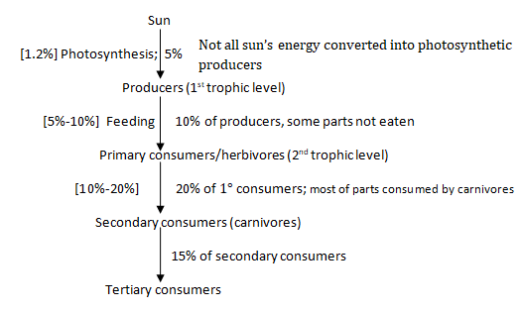
ENERGY FLOW THROUGH AN ECOSYSTEM

Slide 70
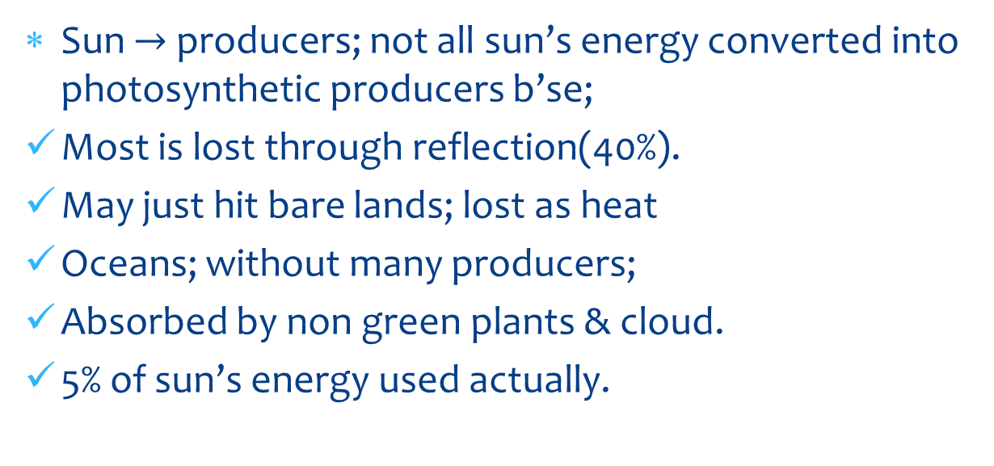
ENERGY FLOW…
Sun $→$ producers; not all sun’s energy converted into photosynthetic producers b’se;
Most is lost through reflection(40%).
May just hit bare lands; lost as heat
Oceans; without many producers;
Absorbed by non green plants & cloud.
5% of sun’s energy used actually.

Slide 71
ENERGY LOSS
@Each trophic level energy is lost through;
Locomotion.
Excretion.
Active transport.
Eating (herbivores).
Involuntary activity[ breathing, circulation e.t.c]
Respiration.
Growth/ cell division.

Slide 72
HINT
Carnivores extract more energy from herbivores b’se;
Animal tissues are more digestable; proteins.
Animal tissues have more energy value
Specialization for prey consumption.
Still less than 100% b’se;
Some animal tissues like bones, ho0ves, horns, nails not eaten/readily digested/unedible.
Most digestable animals materials can be lost.

Slide 73
Hint …
Herbivores extract less energy from producers b’se;
Plant tissues are hard to digesit; cellulose; lack of cellulase in some thus more energy required.
Some parts aren’t eaten by herbivores. E.g. stems, branches e.t.c.
Thus Ecopathy/coprophagy; behaviour of feeding on fecal matter for maximum nutrient derivation.
From top carnivores, all energy is lost as wastes and remains to decomposers & detritivores.

Slide 74
Effects of progressive energy loss
Less energy is left to support organisms at higher trophic levels thus;
Carnivores are few e.g hawks, tigers, white sharks etc
Carnivores easily suffer when supportive systems are disrupted.
Very vulnerable to extinction
NB: The more trophic levels, the greater the cumulative loss of energy during its flow; limits the number of trophic levels to 3/4 & rarely 5 or 6 as energy to support organisms decreases with increase in number of trophic levels.

Slide 75
QUICK CHECK
Explain why in most ecosystems, less than 5% of sunlight is converted into chemical energy by green plants. [08 mks].
With reference to pyramids of energy, discuss the transfer of energy between trophic levels. [10 mks]
Why are there rarely more than 6 links in food chain? [04 marks]

Slide 76
SOLUTION
Most of the sunlight [40%] is reflected immediately by clouds and dust/chemicals in the atmosphere and also off the earth’s surface. 15% of the light energy is absorbed by water vapour and the ozone to be converted into heat energy. The ozone absorbs most of the U.V. radiations which are dangerous to exposed living tissues. The remaining 45% received by earth but some reach on bare rock, shiny oceans thus reflected and non-green plants despite the presence of phytoplanktons. The remaining energy hit green plants but only less than 5% is in photosynthetic active range [PAR].

Slide 77
SOLUTION …
b) Use the schemata provided above
c) Energy is progressively lost as we move from one trophic level to another e.g. during respiration, locomotion etc; add the above.

Slide 78
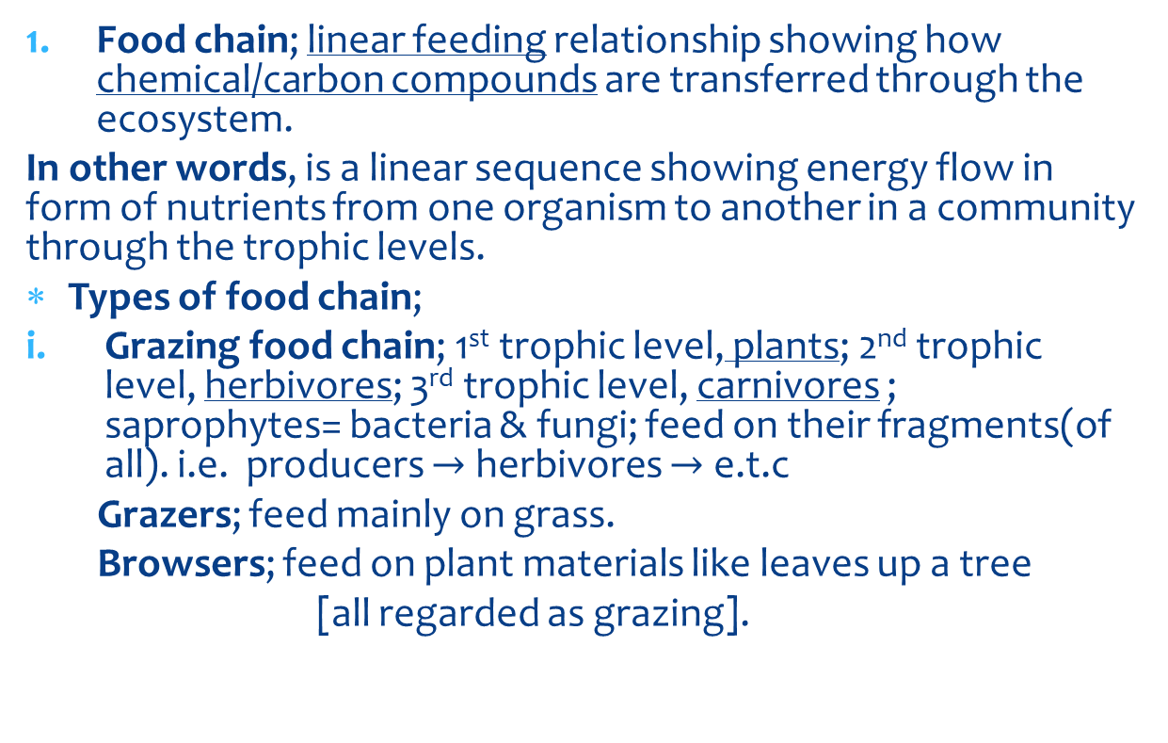
CHANNELS OF ENERGY FLOW
Food chain; linear feeding relationship showing how chemical/carbon compounds are transferred through the ecosystem.
In other words, is a linear sequence showing energy flow in form of nutrients from one organism to another in a community through the trophic levels.
Types of food chain;
Grazing food chain; 1st trophic level, plants; 2nd trophic level, herbivores; 3rd trophic level, carnivores ; saprophytes= bacteria & fungi; feed on their fragments(of all). i.e. producers $→$ herbivores $→$ e.t.c
Grazers; feed mainly on grass.
Browsers; feed on plant materials like leaves up a tree
[all regarded as grazing].

Slide 79
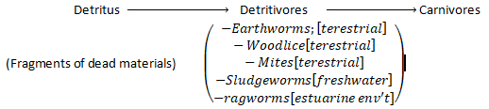
FOOD CHAIN …
ii. Detritus food chain; detritivores feed on organic matter (dead organic materials).
i.e.

Slide 80
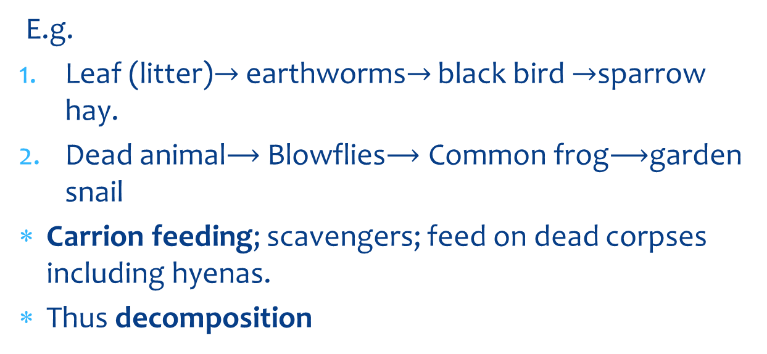
FOOD CHAIN …..
E.g.
Leaf (litter)$→$ earthworms$→$ black bird $→$sparrow hay.
Dead animal Blowflies Common frog garden snail
Carrion feeding; scavengers; feed on dead corpses including hyenas.
Thus decomposition

Slide 81
DECOMPOSITION
CONDITIONS:
Decomposers; bacteria& fungi presence[saprophytes].
Temperature/warmth
Nature of substrate; animal organic matter; plant materials [take longer]; cellulose + wood (1st produce cellulase of decomposition to occur)
Moisture.
Warm, moist; good conditions for decomposers to develop.
For cold regions; say temperate; cool, moist; decomposition takes long.
In desert areas; longer time; conditions are warm but dry.

Slide 82
CHANNELS OF ENERGY FLOW…
2. Food web; an interlinked feeding relationship showing alternative food sources of organisms in an ecosystem.
In other words; Complex nutritional relationship showing alternative food sources for each organism in a food chain i.e. a food chain.
E.g: Aquatic food web (pg 534/ FA)

Slide 83
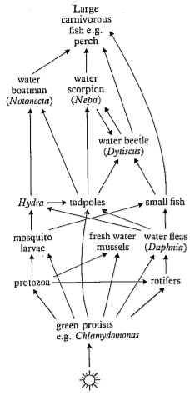
FOOD WEB…

Slide 84
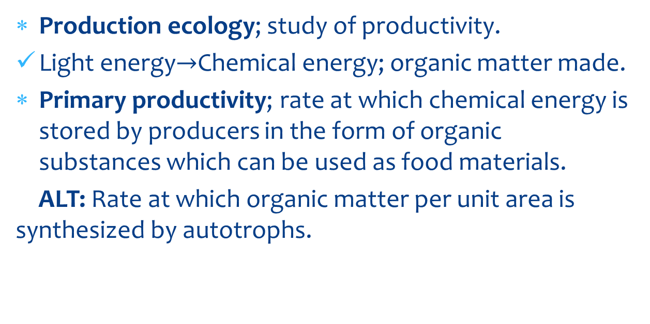
EFFICIENCY OF ENERGY TRANSFER
Production ecology; study of productivity.
Light energy Chemical energy; organic matter made.
Primary productivity; rate at which chemical energy is stored by producers in the form of organic substances which can be used as food materials.
ALT: Rate at which organic matter per unit area is synthesized by autotrophs.

Slide 85
ENERGY TRANSFER…
Gross primary productivity (GPP); Rate at which chemical energy is stored by green plants per unit area; per unit time.
Total amount of energy fixed by producers per unit area of photosynthetic surface per unit time.
Net primary productivity (NPP) ; Rate at which chemical energy is stored by autotrophs minus energy loss due to respiration + photorespiration.
Rate at which chemical energy for use by consumers is stored as organic substances by producers
i.e. NPP = GPP –(Respiration + photorespiration)
Notes:
GPP; Rate of conversion of solar energy into chemical energy by producers per unit photosynthetic area.

Slide 86
NOTE:
GPP is higher in shallow waters, along coral reefs; water currents bring ocean N2 &P.
Is lower in deserts; reduced precipitation + increase heat; and in open ocean due to lack of nutrients.
NPP is higher in estuarines, swamps & marshes and tropical rain forests.
It is lower in open ocean, tundra (arctic- glass lands) and in deserts.
Despite low NPP, open ocean produces more organic matter than earth’s NPP per year due to large size.

Slide 87
ENERGY TRANSFER…
Secondary productivity; Rate at which energy is used to make biomass in consumers. It is for growth; repair and reproduction.
2o prodn; energy incorporation in heterotrophs.
NSP; GSP-losses thru egestion, excretion+respiration.
Notes:
NSP; GSP-losses thru egestion, excretion+respiration.

Slide 88
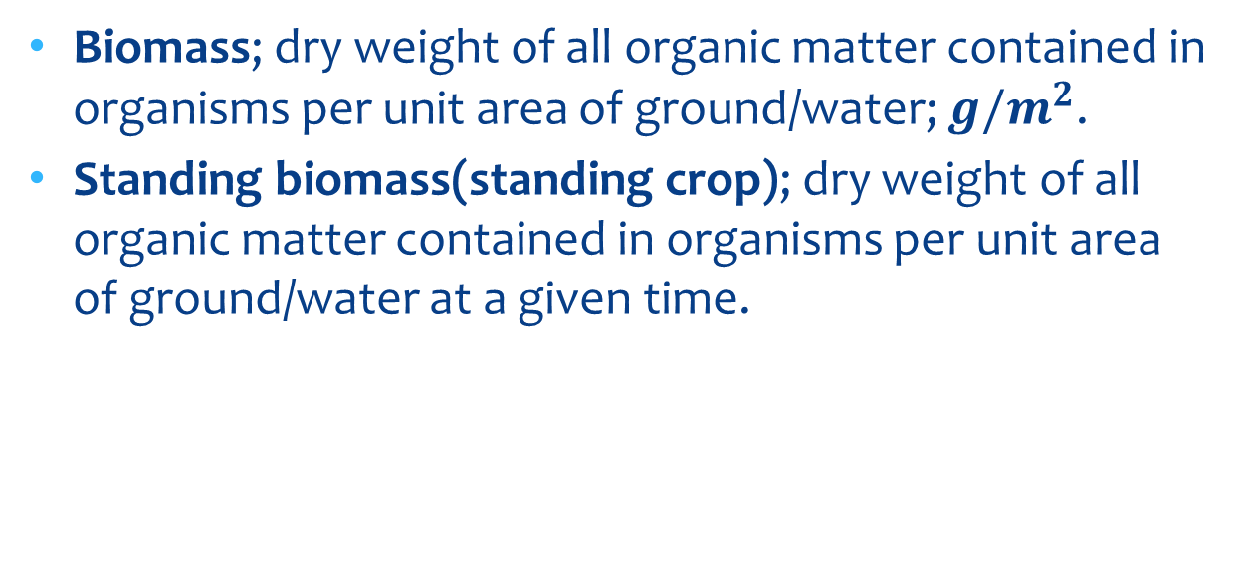
ENERGY TRANSFER…
Biomass; dry weight of all organic matter contained in organisms per unit area of ground/water; ${g/m}^{2}$.
Standing biomass(standing crop); dry weight of all organic matter contained in organisms per unit area of ground/water at a given time.

Slide 89
ENERGY TRANSFER…
NB: Units of energy indicate the rate of synthesis [productivity & consumption] of organic matter; unit of biomass only represent amount of organic matter in time at a given moment [standing crop].
Biomass determination; representative individuals/producers are weighted; their number recorded; total mass of all producers is estimated.

Slide 90
HINT
Primary productivity is higher in intensely cultivated land than in grassland because; High biodiversity; use of fertilizers in cultivated lands; increasing nutrient content; increased evapotranspiration; may increase rainfall amounts received; increased death & decay at the end of growing seasons; increasing nutrient content; some cultivated plants may improve soil quality e.g. legumes.

Slide 91
Hint …
Primary productivity is higher in tropical forest than temperate forest
High temperatures in tropics than temperate regions.
Rainfall amounts high in tropics.
Longer days & high light intensities in tropics.
High biodiversity in tropical forests; increases decomposition rate/ rate of recycling nutrients.

Slide 92
ECOLOGICAL PYRAMIDS
Defn: Diagrammatic representation of either number, biomass or energy at each trophic level in a food chain per unit area/ per unit volume [in a given time =energy].
Histograms providing information about of trophic levels in ecosystems.
Pyramid of number;
Is histographic representation number of individuals at each trophic level in a food chain per unit area/per unit volume at any time. Elton and Lindeman.
Numbers progressively decrease as we ascend the pyramid.
Can be inverted e.g. many aphids/caterpillars on a single tree

Slide 93
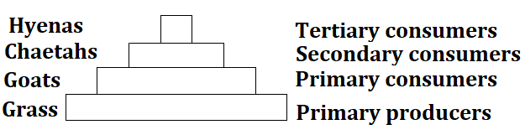
Pyramid of number

Slide 94
Qn: Why generally the pyramid goes on decreasing?
To prevent starvation; there should be many being fed on by a few.
Advantage
Numbers are easy to count.
Disadvantages
Puts no account for immature forms[young forms; diff. diet from adults, yet are considered together].
Hard to draw, to scale as the range of numbers may be great.
Vary greatly in size; the producers greatly vary e.g. algae & plants and are given the same status.
The trophic level of an organism is difficult to ascertain [general limitation throughout]
May be inverted if producer is large e.g. fleas on a dog, caterpillars on mango tree etc.

Slide 95
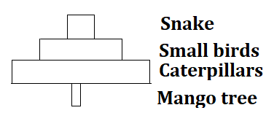
Example of inverted pyramid of no.s

Slide 96
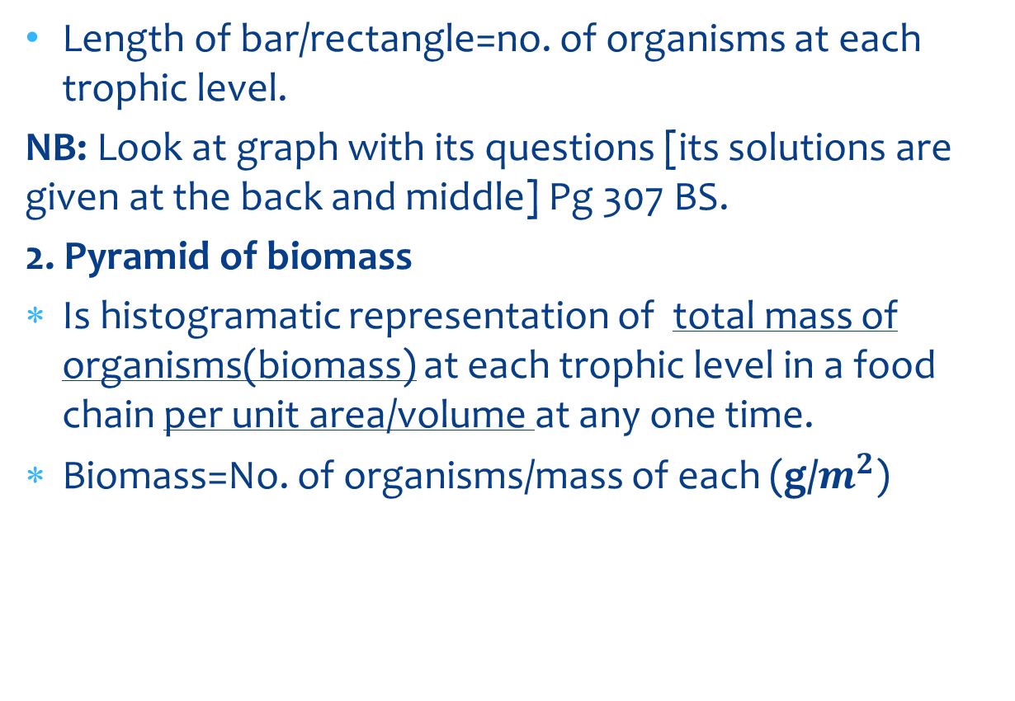
…
Length of bar/rectangle=no. of organisms at each trophic level.
NB: Look at graph with its questions [its solutions are given at the back and middle] Pg 307 BS.
2. Pyramid of biomass
Is histogramatic representation of total mass of organisms(biomass) at each trophic level in a food chain per unit area/volume at any one time.
Biomass=No. of organisms/mass of each (g/$m^{2}$)

Slide 97
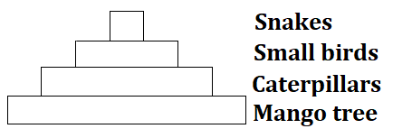
Pyramid of biomass

Slide 98
P.Biomass …
Advantage
It can be used to compare different ecosystems.
Eliminates scale problems
Limitations/disadvantages
Expensive & tiresome to obtain the total mass of organisms.
May involve killing organism in case of use of dry weight.
Less reliable; the sample used may not be the actual representation of all individuals’ biomass.
Doesn’t indicate rate of productivity.
Producers possess different turnover rates.
Difficult to ascertain trophic level of an organism.
May vary from one time of the year to another e.g. deciduous trees in winter and summer.
Inverted if primary consumers eat the producers as fast as they are produced e.g. zooplanktons & phytoplanktons.

Slide 99
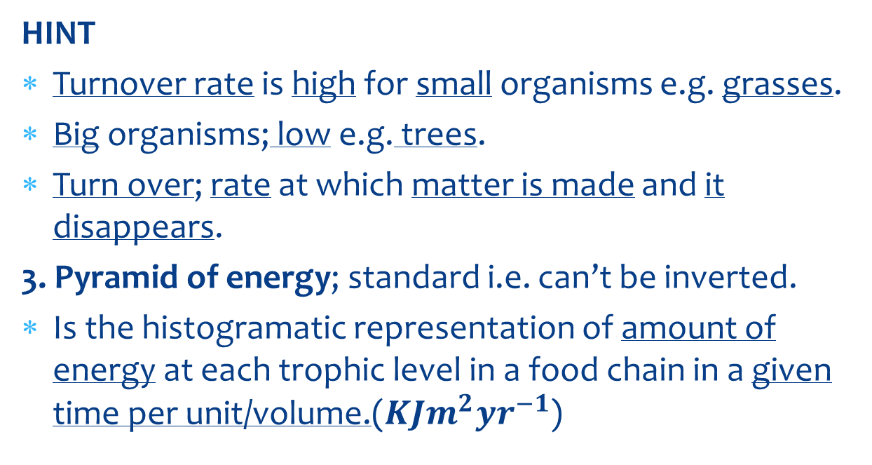
Pyramids …..
HINT
Turnover rate is high for small organisms e.g. grasses.
Big organisms; low e.g. trees.
Turn over; rate at which matter is made and it disappears.
3. Pyramid of energy; standard i.e. can’t be inverted.
Is the histogramatic representation of amount of energy at each trophic level in a food chain in a given time per unit/volume.($KJm^{2}{yr}^{−1}$)

Slide 100
Pyramid of energy
Some ecologists; PYRAMID OF ENERGY FLOW; since it doesn’t show energy stored.
Defn: Histogramatic representation of the flow of energy through each trophic level of an ecosystem during a fixed time period. (Usually 1 yr to account for seasonal effects)

Slide 101
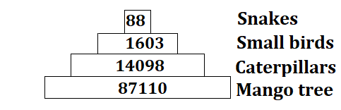
P.Energy ….

Slide 102
NOTE
It shows how more people are supported on earth by feeding at lower trophic levels like on grains, vegetables and fruits rather than on grain eaters.

Slide 103
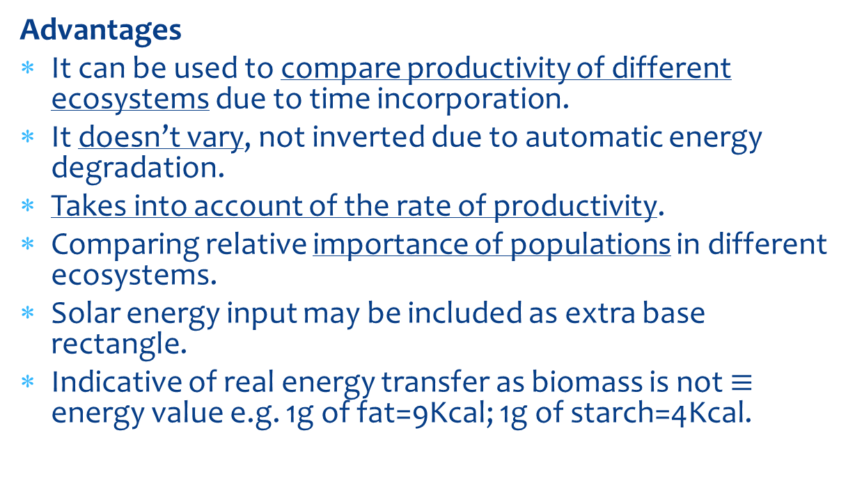
P.Energy …
Advantages
It can be used to compare productivity of different ecosystems due to time incorporation.
It doesn’t vary, not inverted due to automatic energy degradation.
Takes into account of the rate of productivity.
Comparing relative importance of populations in different ecosystems.
Solar energy input may be included as extra base rectangle.
Indicative of real energy transfer as biomass is not $≡$ energy value e.g. 1g of fat=9Kcal; 1g of starch=4Kcal.

Slide 104
P.Energy …
Limitations/disadvantages
It is difficult to obtain necessary data for its construction.
Difficulty of locating organisms’ trophic levels.
The weight of the organism doesn’t give the amount of energy.

Slide 105
POPULATION ECOLOGY
………….STILL TO COME

